Slide 1
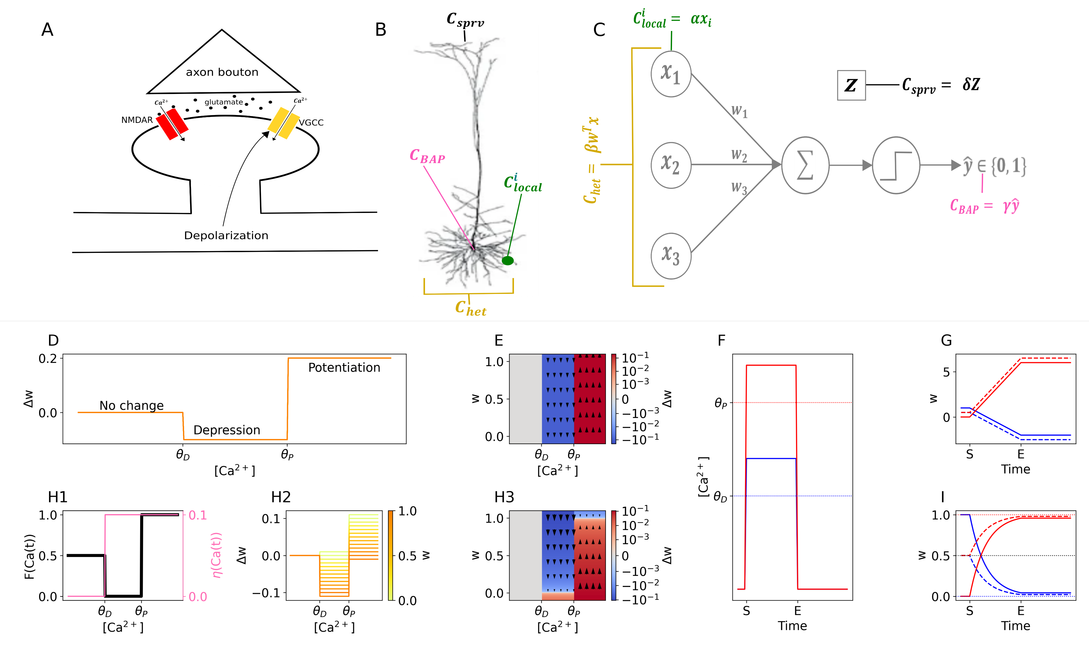
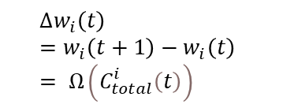
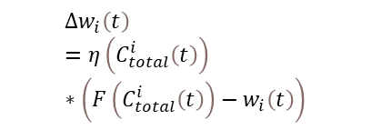
The Calcitron
$$Δw_{i}\left(t\right)=w_{i}\left(t+1\right)−w_{i}\left(t\right) = Ω\left(C_{total}^{i}\left(t\right)\right)$$
$$Δw_{i}\left(t\right)=η\left(C_{total}^{i}\left(t\right)\right)∗\left(F\left(C_{total}^{i}\left(t\right)\right)−w_{i}\left(t\right)\right)$$

Slide 2
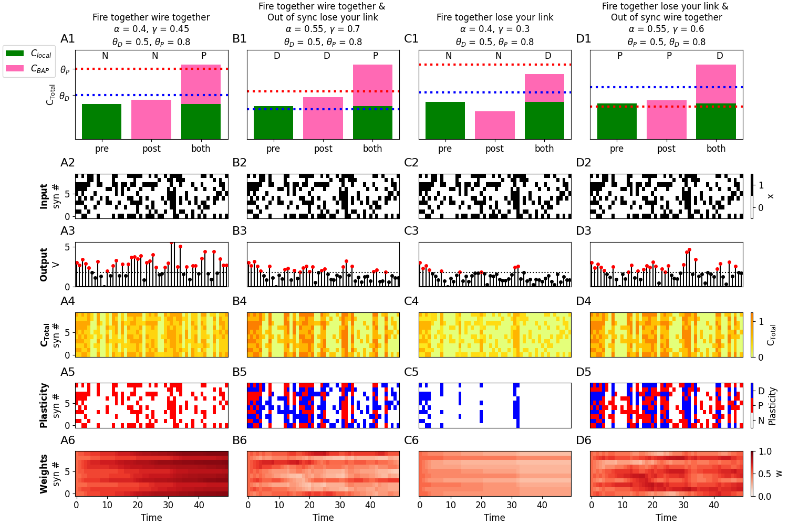
Hebb and Anti-Hebb

Slide 3
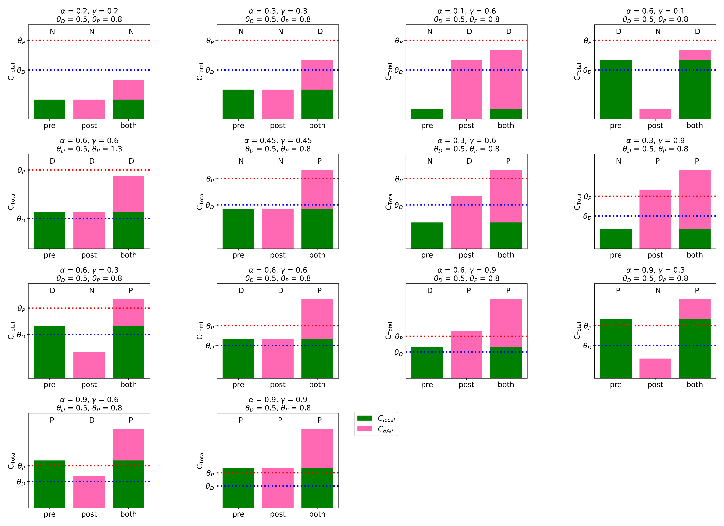
14 Pre-Post rules

Slide 4
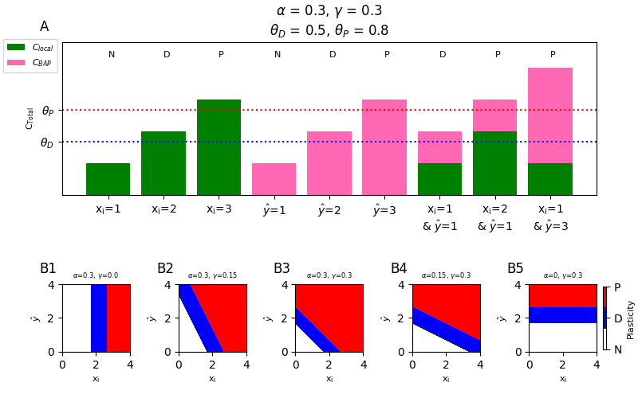
Pre-and-Post Frequency Dependent

Slide 5
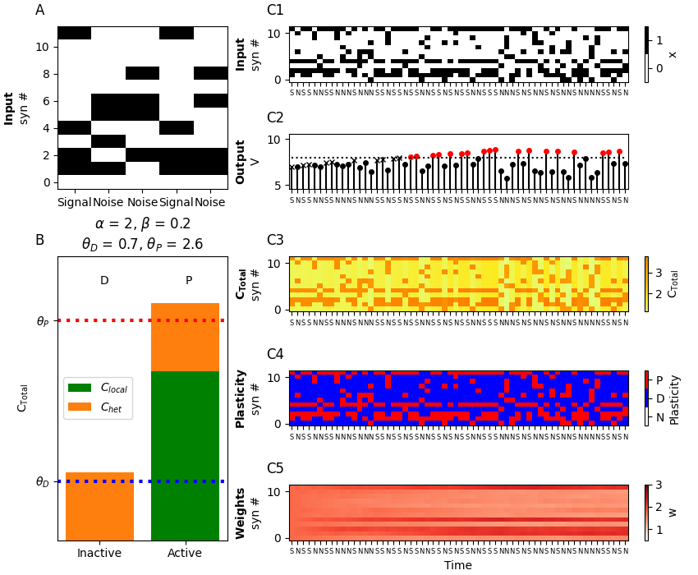
Unsupervised Learning of Frequent Patterns

Slide 6
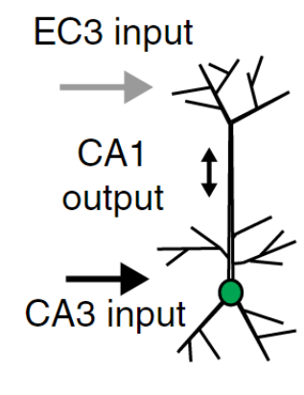
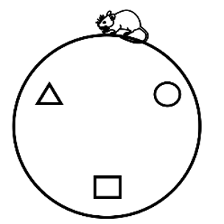
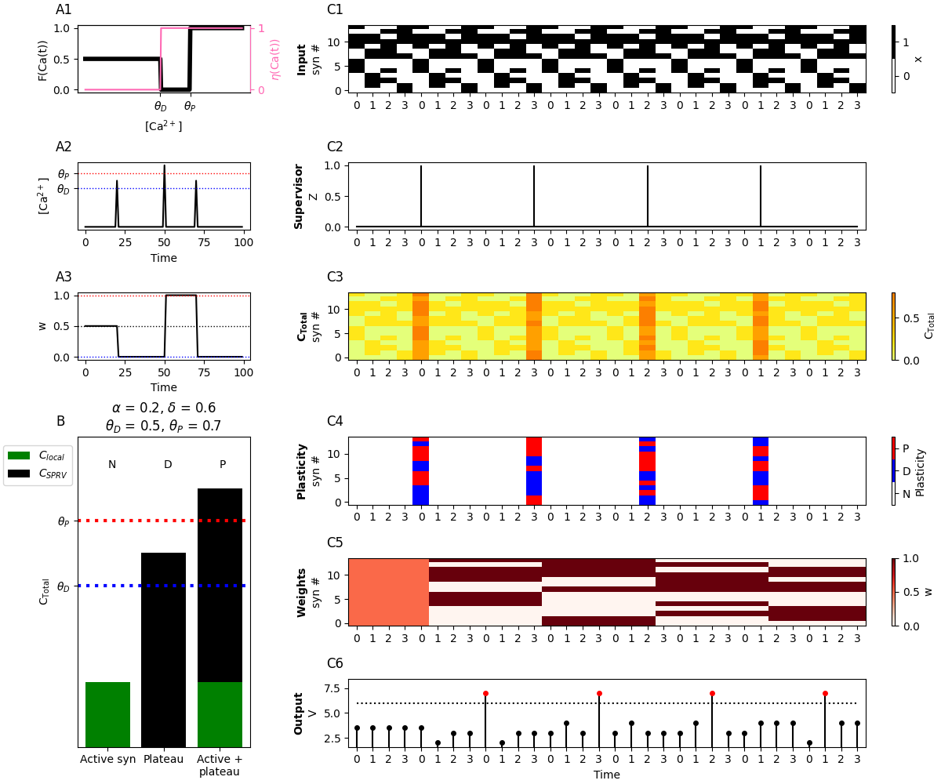
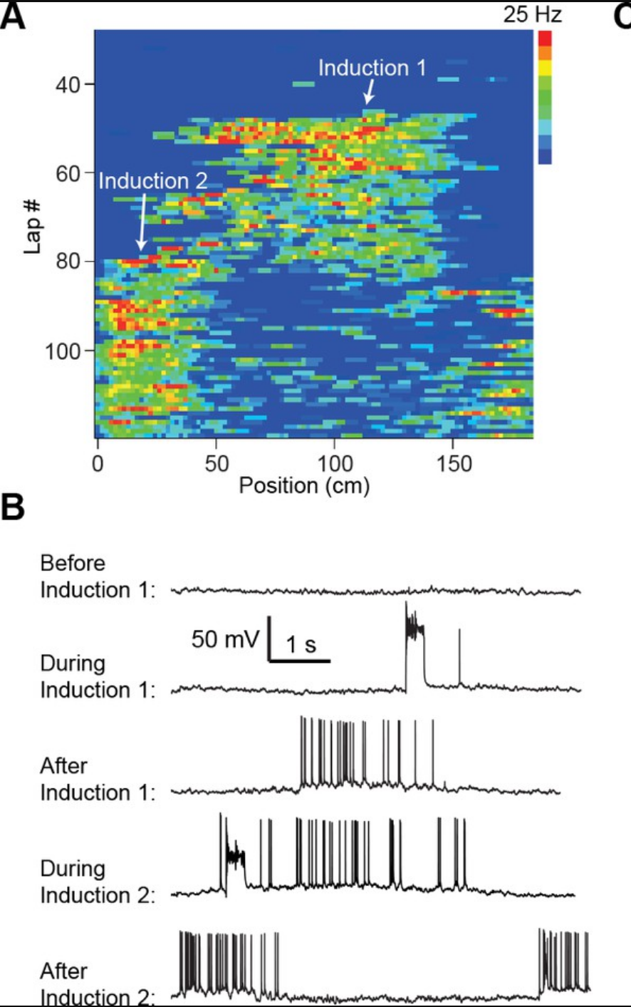
1SFF/BTSP
Bittner, K. C., Grienberger, C., Vaidya, S. P., Milstein, A. D., Macklin, J. J., Suh, J., Tonegawa, S., & Magee, J. C. (2015). Conjunctive input processing drives feature selectivity in hippocampal CA1 neurons. Nature Neuroscience, 18(8), 1133–1142. https://doi.org/10.1038/nn.4062
Milstein, A. D., Li, Y., Bittner, K. C., Grienberger, C., Soltesz, I., Magee, J. C., Romani, S. (2021). Bidirectional synaptic plasticity rapidly modifies hippocampal representations.

Slide 7
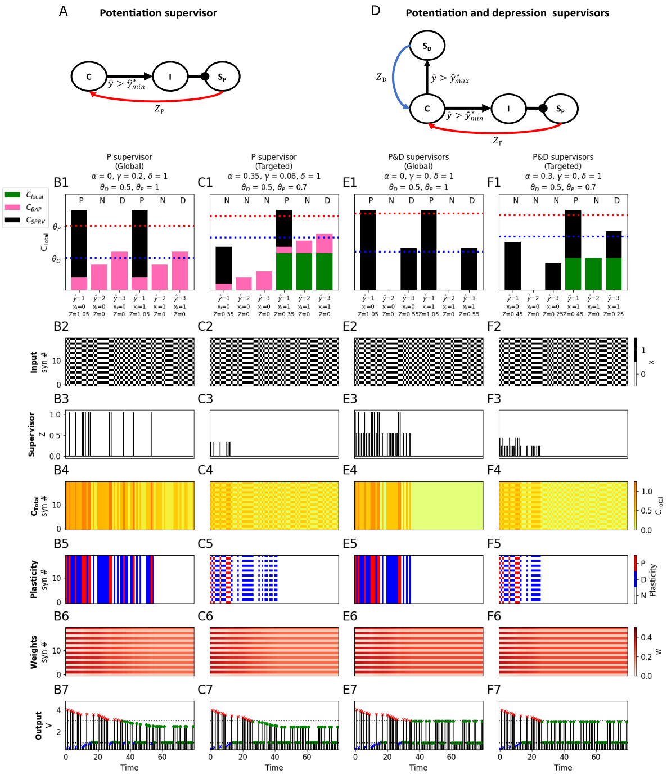
Homeostatic Plasticity

Slide 8
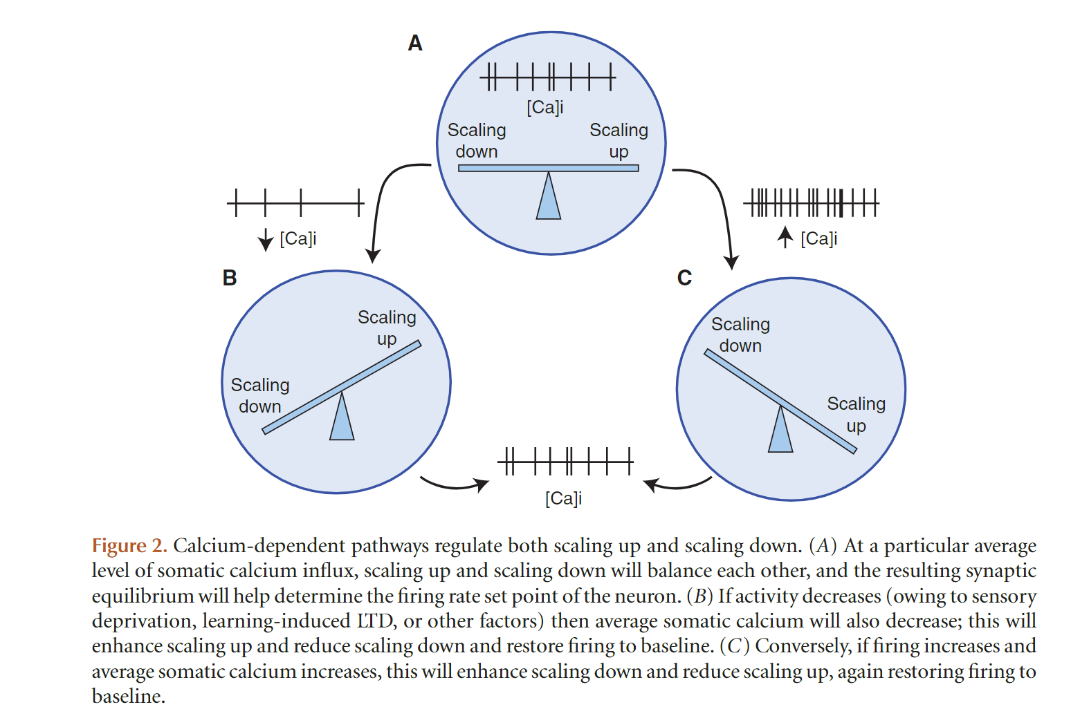
How Homeostatic Plasticity Actually Works
Turrigiano, G. (2012). Homeostatic synaptic plasticity: local and global mechanisms for stabilizing neuronal function. Cold Spring Harbor Perspectives in Biology, 4(1). https://doi.org/10.1101/CSHPERSPECT.A005736

Slide 9
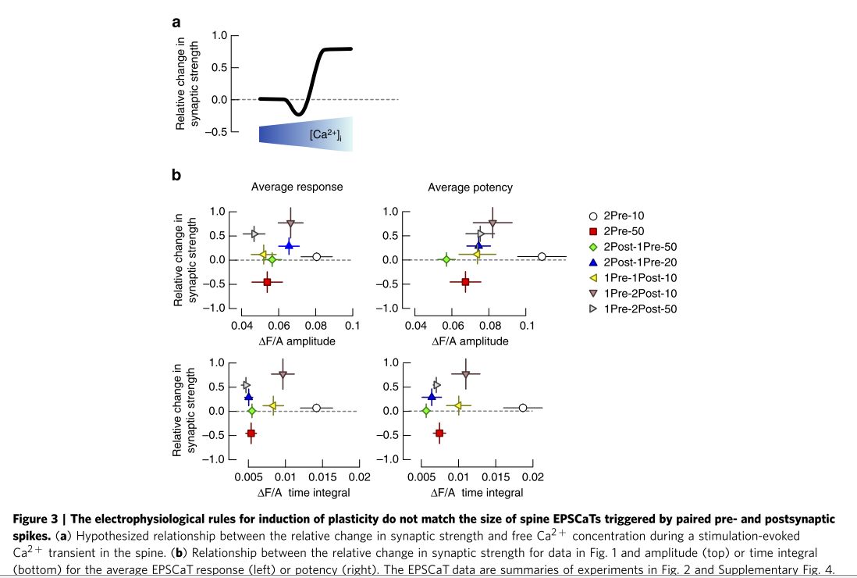
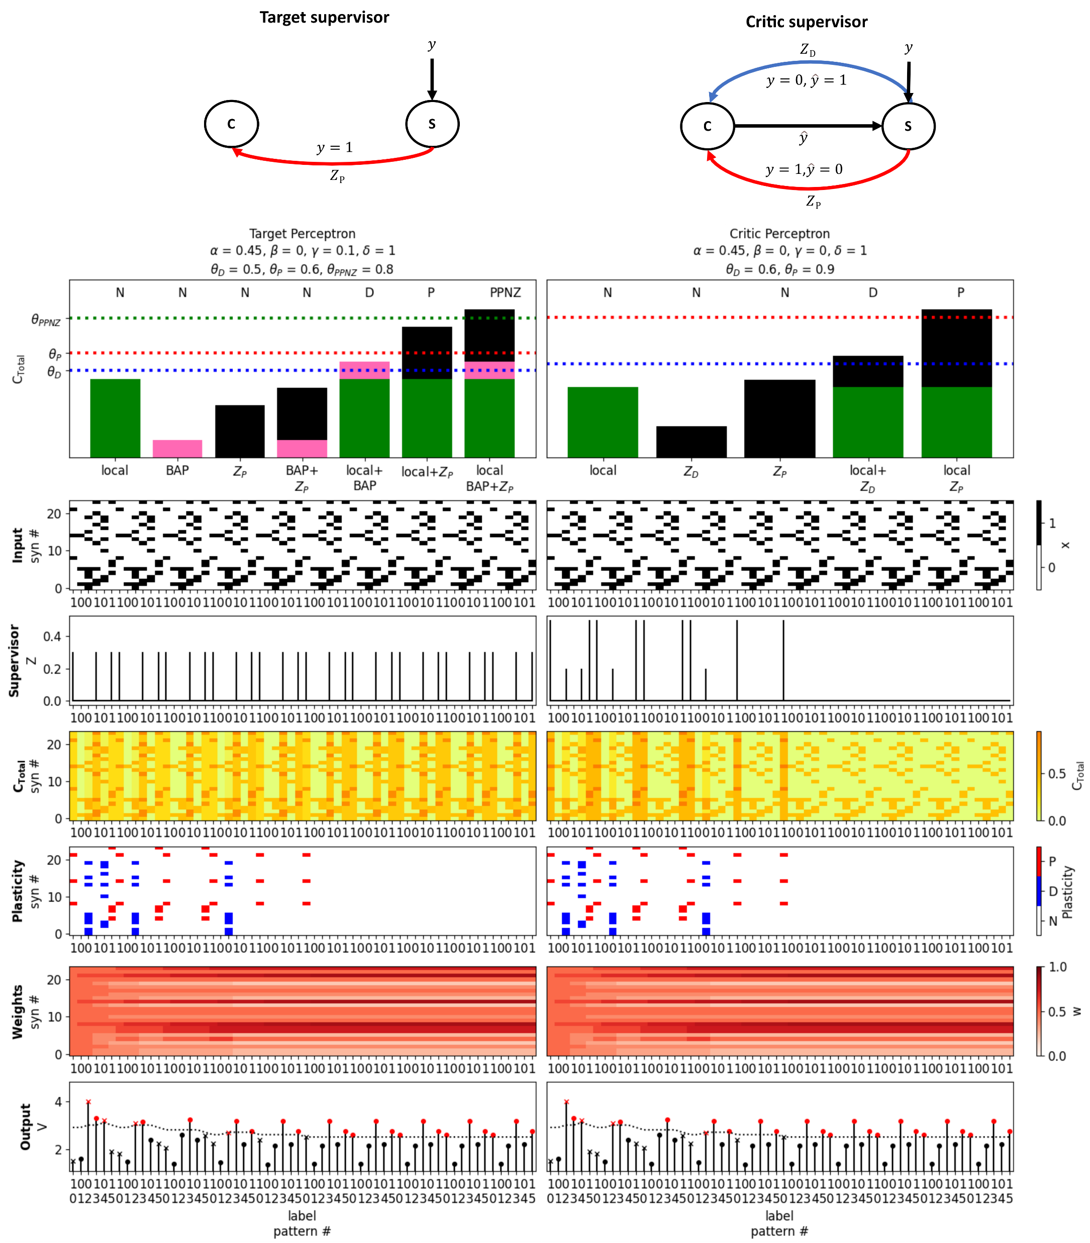
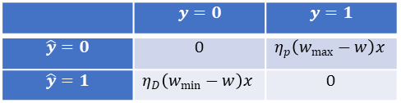
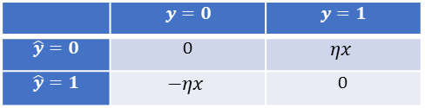
Perceptron
Linear
 | $$y=0$$ | $$y=1$$
$$\hat{y}=0$$ | 0 | $$ηx$$
$$\hat{y}=1$$ | $$−ηx$$ | 0
FPLR
 | $$y=0$$ | $$y=1$$
$$\hat{y}=0$$ | 0 | $$η_{p}\left(w_{max}−w\right)x$$
$$\hat{y}=1$$ | $$η_{D}\left(w_{min}−w\right)x$$ | 0

